Slide 1
Chongqing University of Technology
ATAI
Advanced Technique of Artificial Intelligence
Chongqing University of Technology
On Self-Distilling Graph Neural Network
Yuzhao Chen,1,2 , Yatao Bian,2 , Xi Xiao,1 , Yu Rong,2 , Tingyang Xu,2 , Junzhou Huang 2,3
1Tsinghua Shenzhen International Graduate School, Tsinghua University, Shenzhen, China 518057,
2Tencent AI Lab, Shenzhen, China 518057,
3University of Texas at Arlington, Arlington, TX 76019,
IJCAI_2021
Reported by Xinsheng Wang

Slide 2
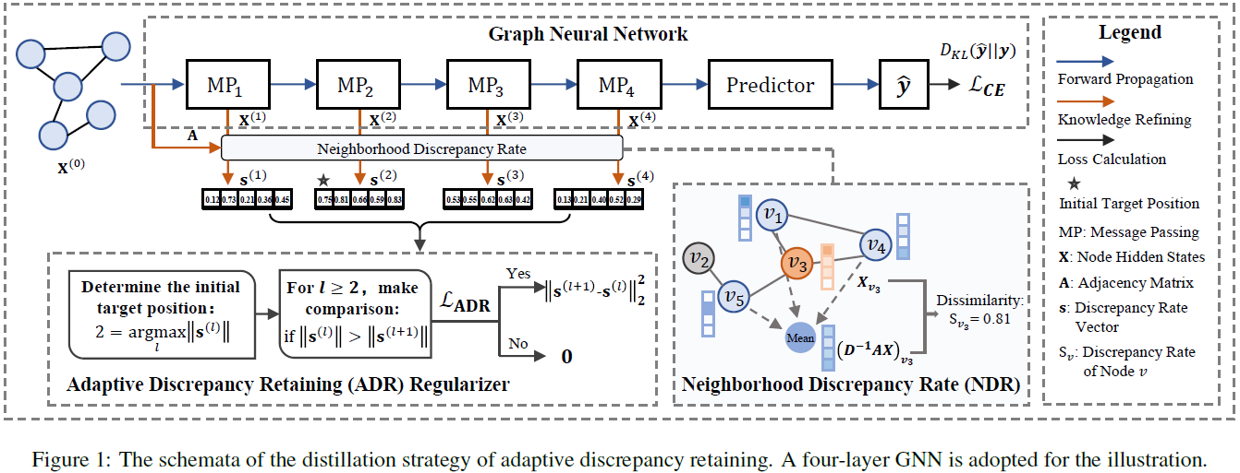
Method

Slide 3
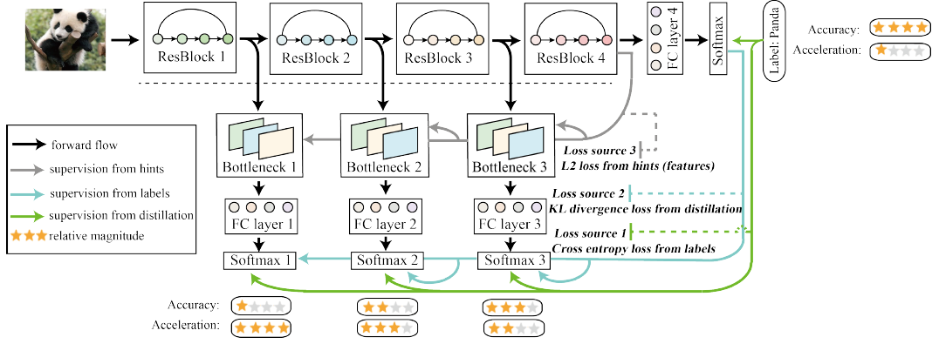

Slide 4
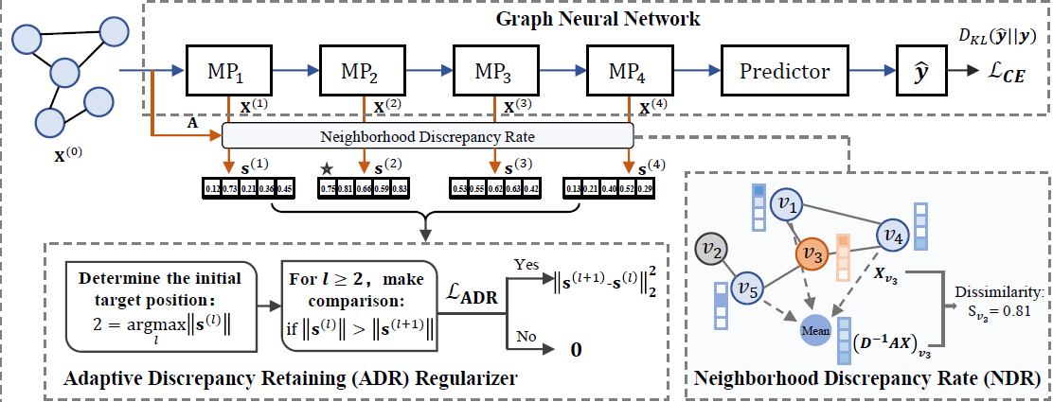
Method
Neighborhood Discrepancy Rate
Strategy for Retaining Neighborhood Discrepancy

Slide 5
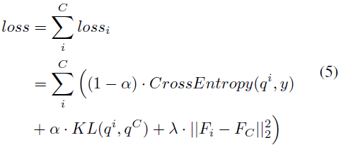
Method
Generic GNN-SD Framework
Overall Loss
cite_2019_Be Your Own Teacher Improve the Performance of Convolutional NeuralNetworks via Self Distillation
Notes:
相对熵

Slide 6
Experiments

Slide 7
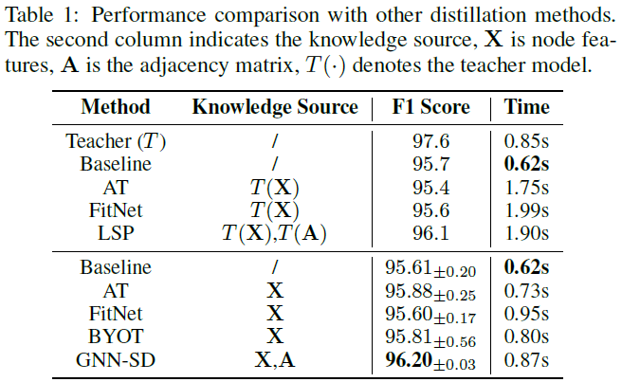
Experiments
Notes:
上面是又teacher model，下面是自蒸馏

Slide 8
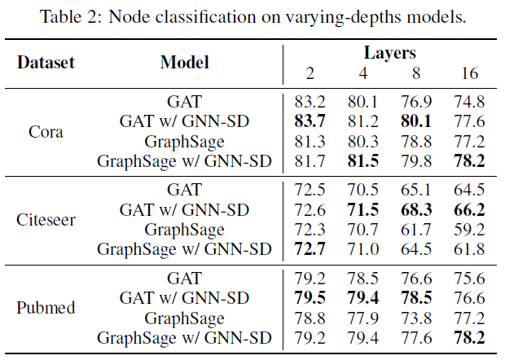
Experiments

Slide 9
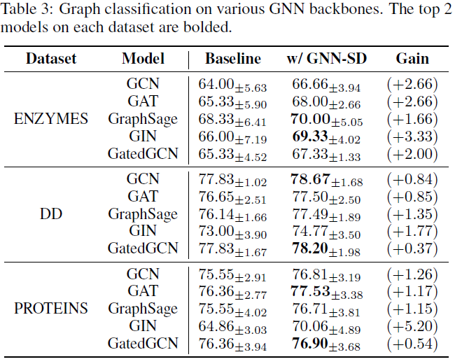
Experiments

Slide 10
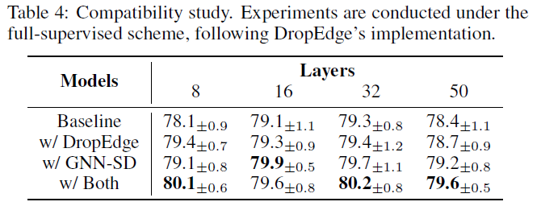
Experiments
ICLR_2019_Dropedge: Towards deep graph convolutional networks on node classification

Slide 11
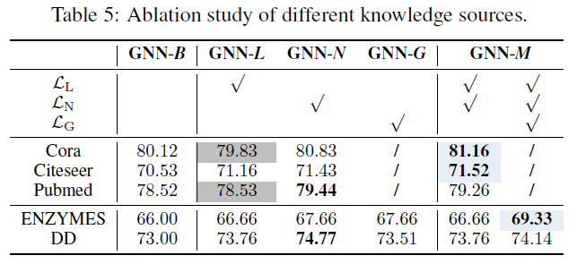
Experiments

Slide 12
Thank you!

